Slide 1




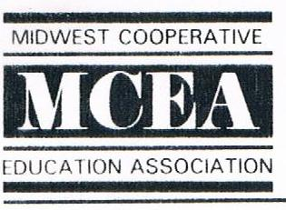
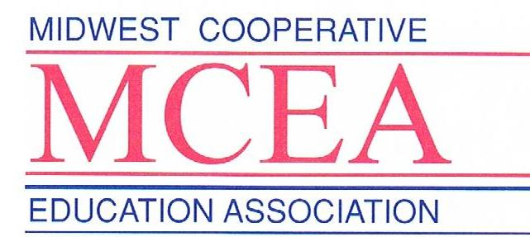
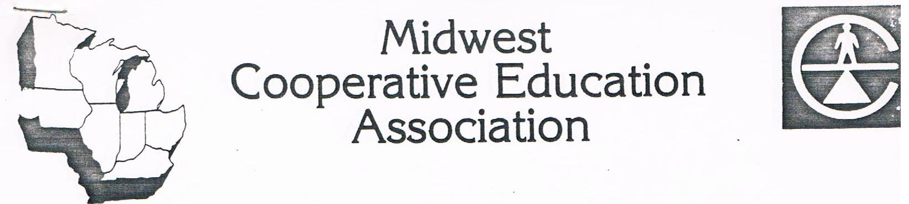

Slide 2
Looking
back
the through the years

Slide 3
Thursday, October 23, 1975

Slide 4
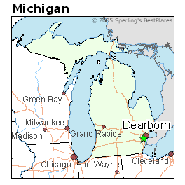
65 interested persons met at Dearborn, Michigan and officially founded the
Midwest Cooperative Education Association
MCEA

Slide 5
MCEA brought together like minded individuals and what came from the group is a tradition……

Slide 6





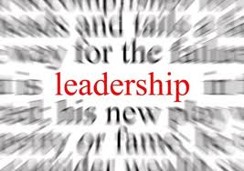








Slide 7
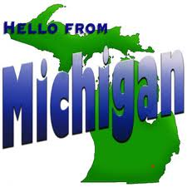
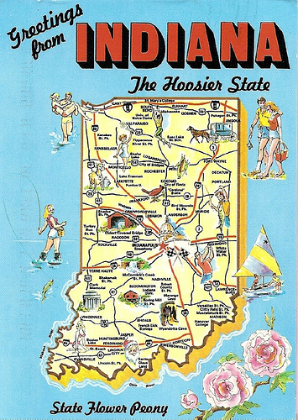
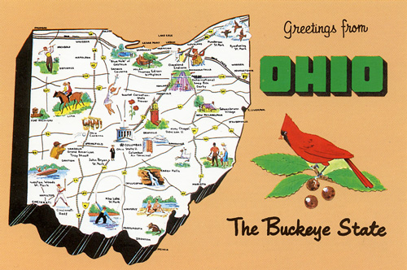
First Came

Slide 8
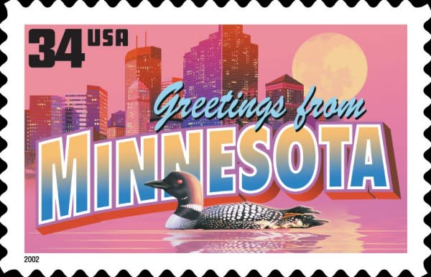


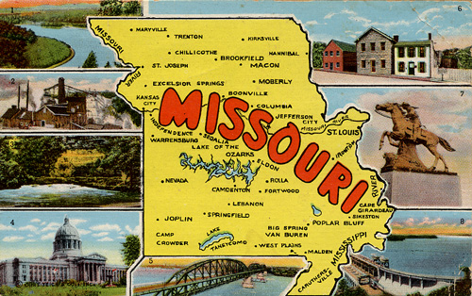
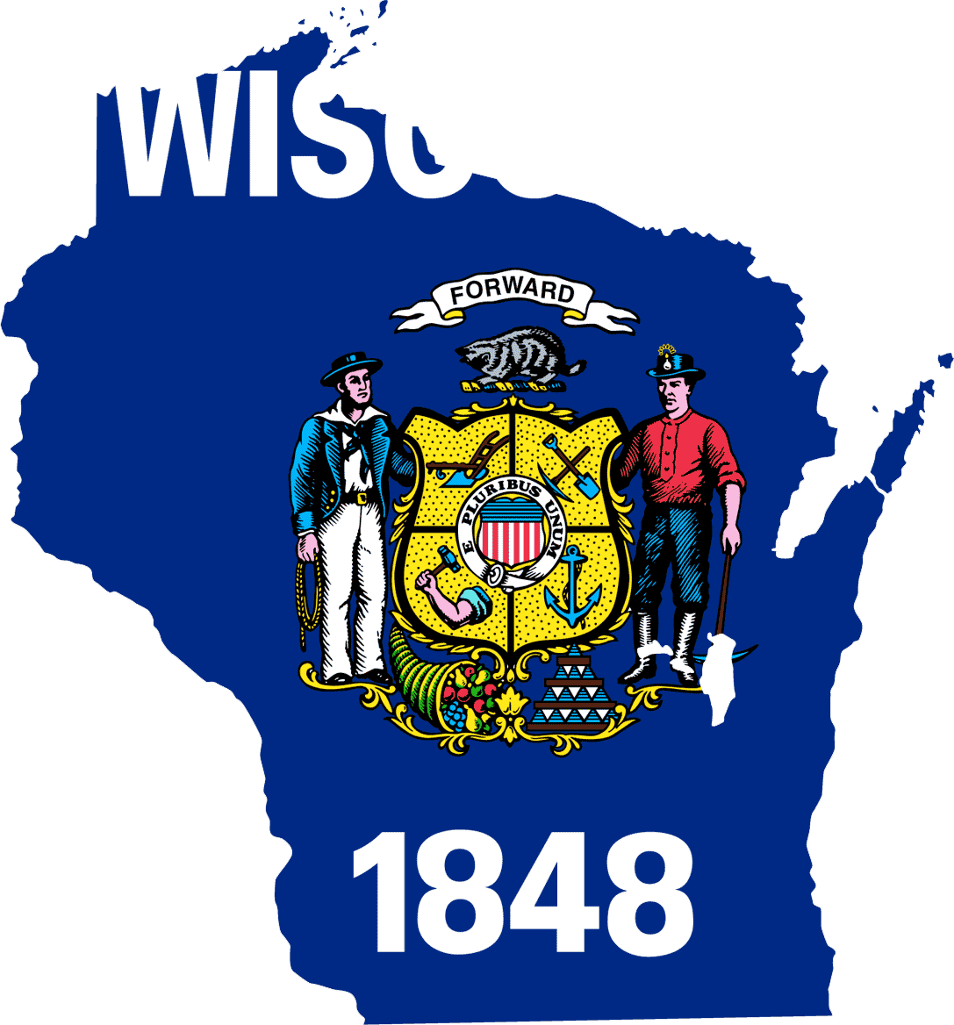

Later Joined by

Slide 9
The original officers were:
Past President & Publicity, Jack Crusoe, University of Detroit
President Jim Chambers, Burroughs Corporation
President-Elect Marshall McGee, Central State University
Membership Herb Peters, Ford Motor Company
Secretary/Treasurer Virginia Lewis, University of Michigan of MI Dearborn
Program Chair Gene Hamilton, Saginaw Valley State

Slide 10


Slide 11
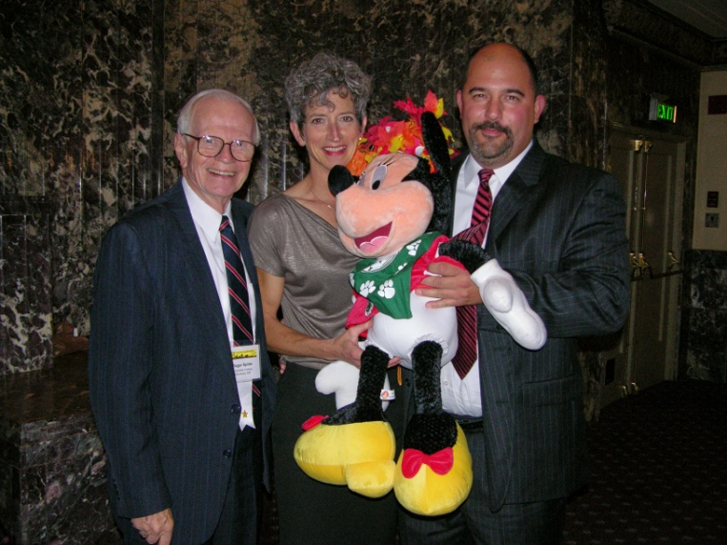
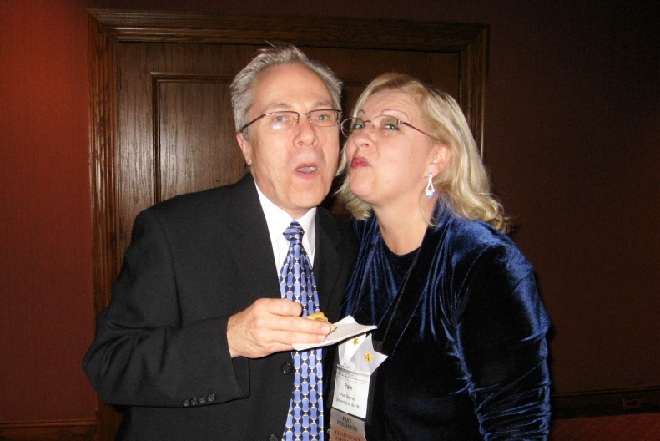
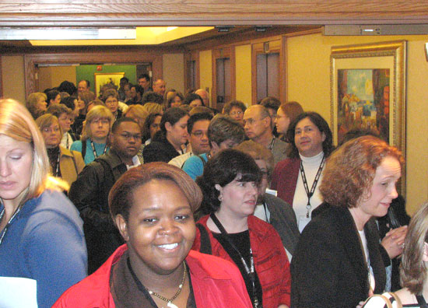
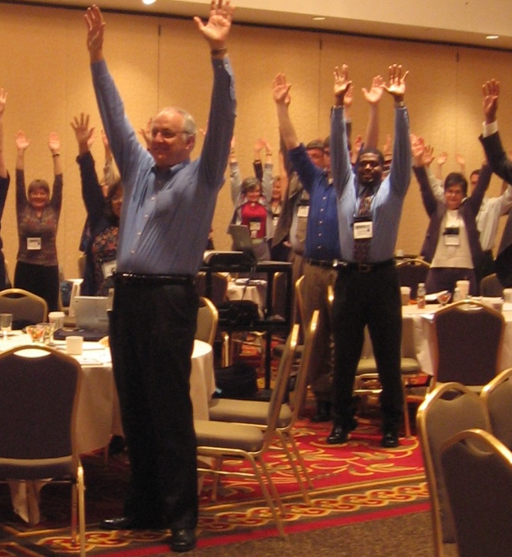
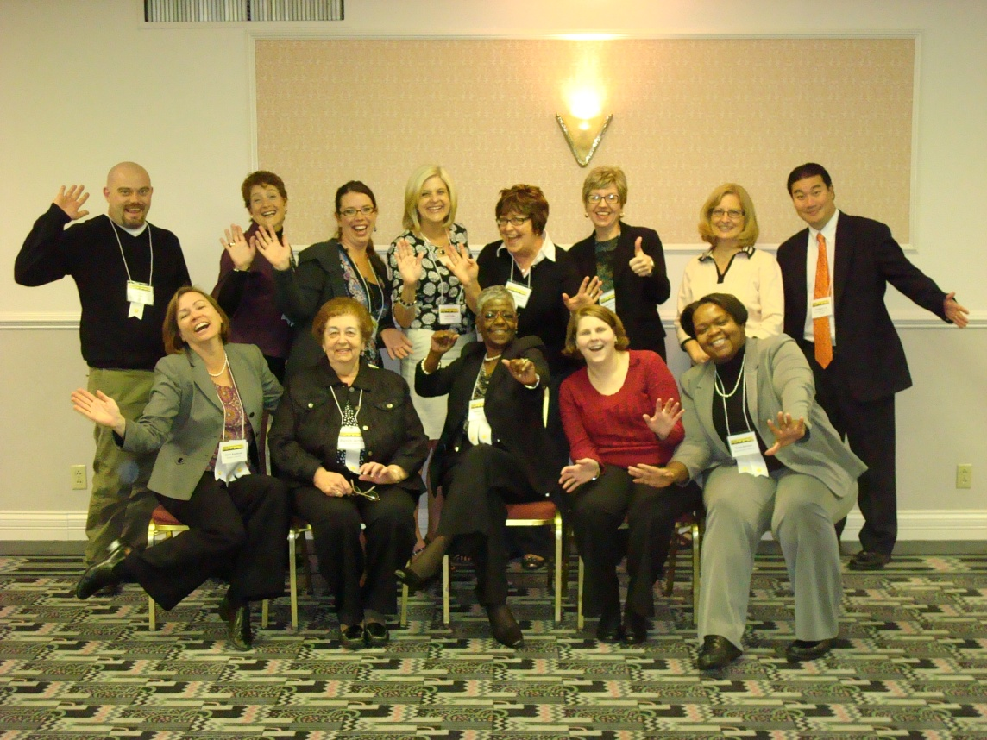
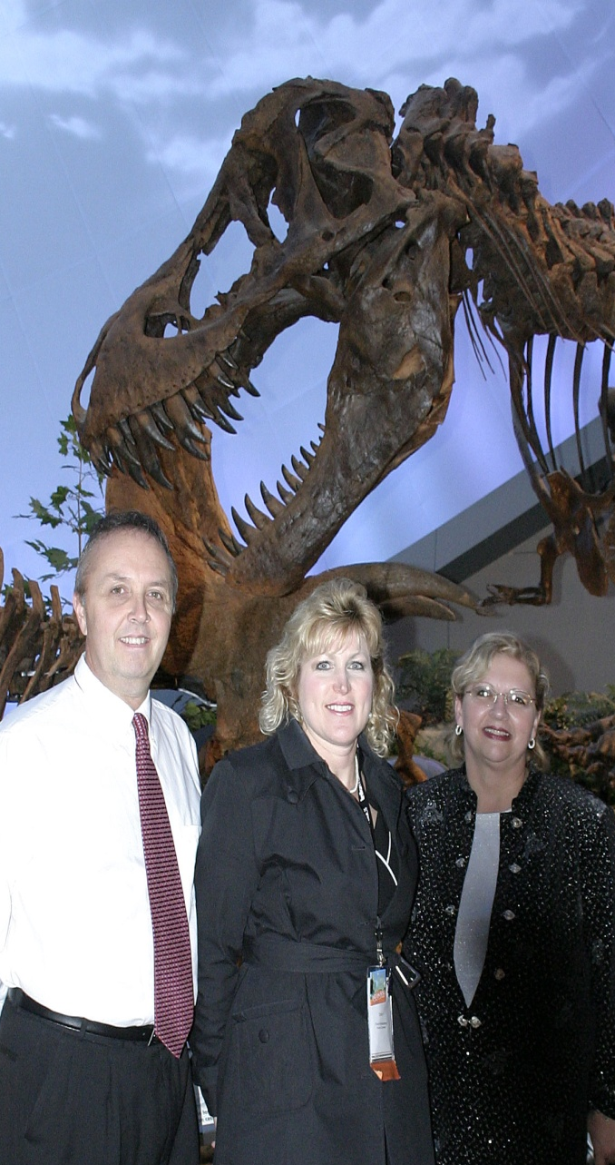
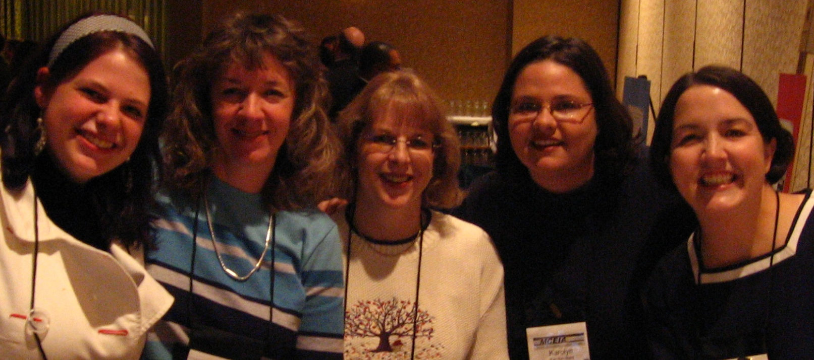

Slide 12


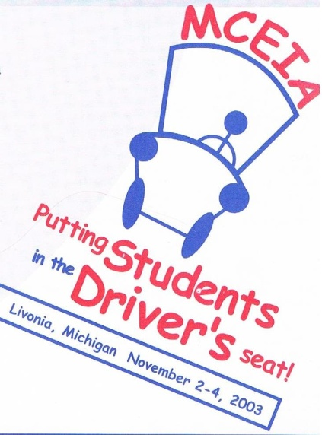

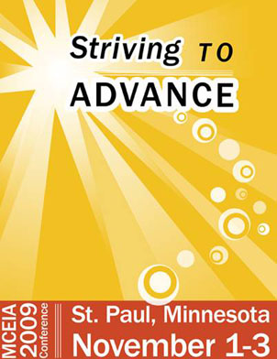
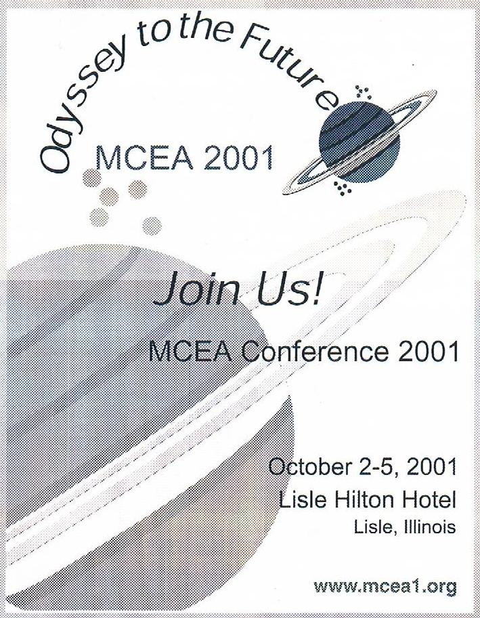
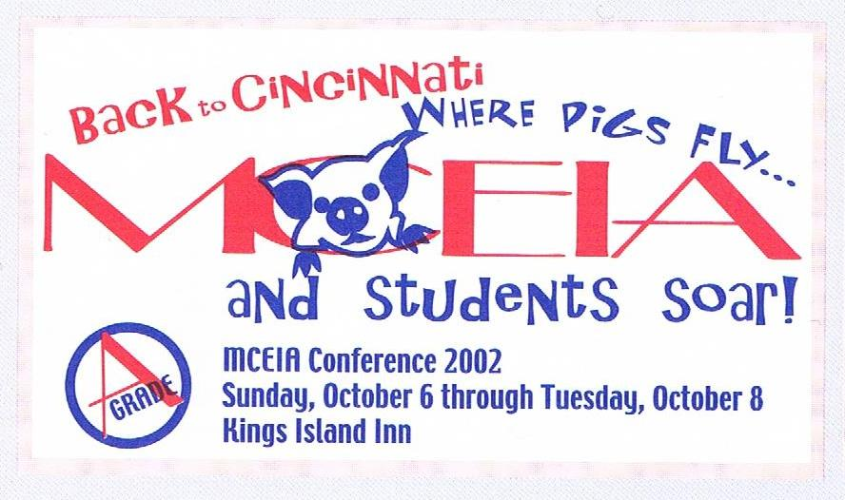
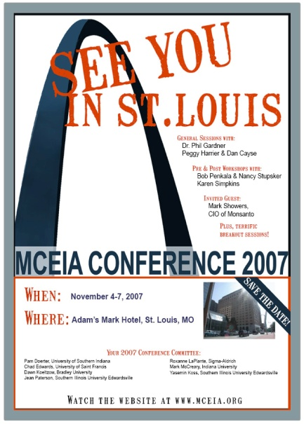
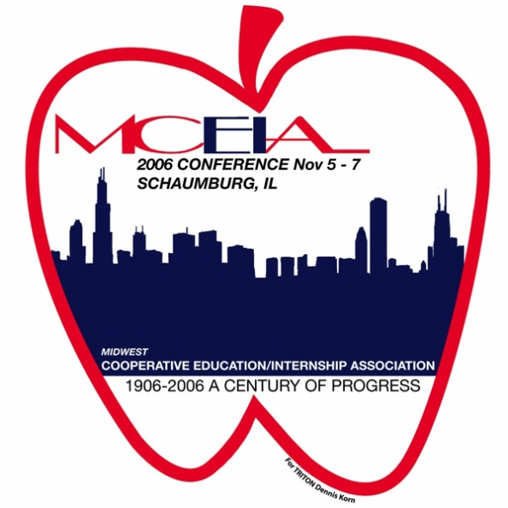


Slide 13
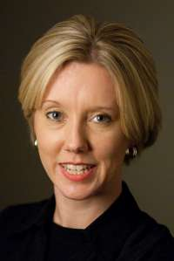
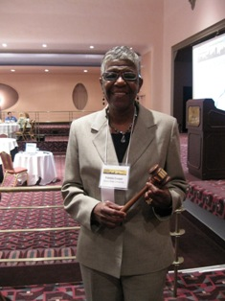
MCEIA Presidents
Beth Haggenjos – 2011-12
Indiana University, IUPUI
Pam Cooper – 2010-11
Illinois State University

Slide 14
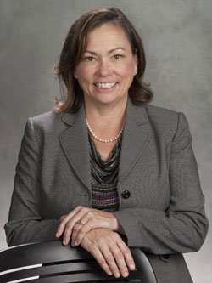
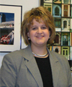
MCEIA Presidents
Dawn Koeltzow – 2009-10
Bradley University
Kelly Harper – 2008 – 09
Cincinnati State

Slide 15
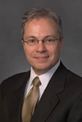
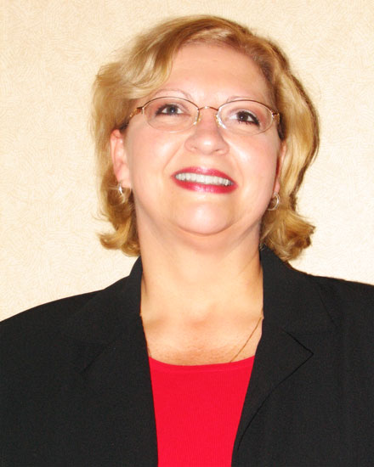
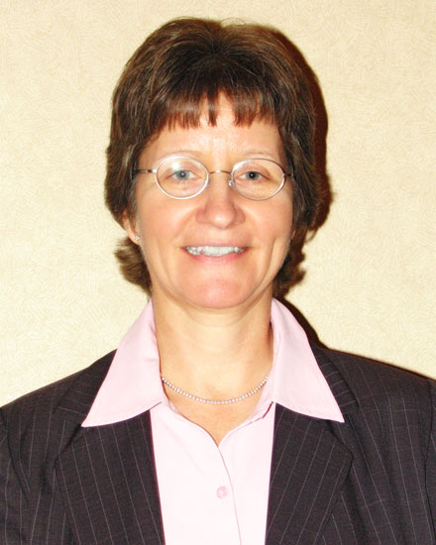
MCEIA Presidents
W. Mark McCreary – 2007-08
Indiana University
Jean Spahr – 2006-07
College of DuPage
Pam Doerter– 2005-06
University of Southern Indiana

Slide 16
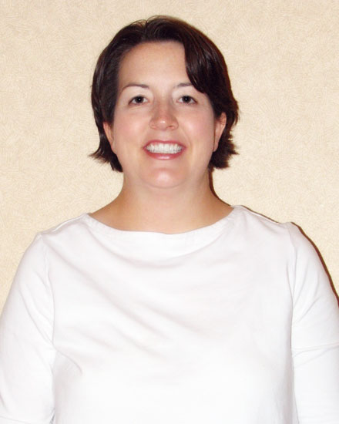
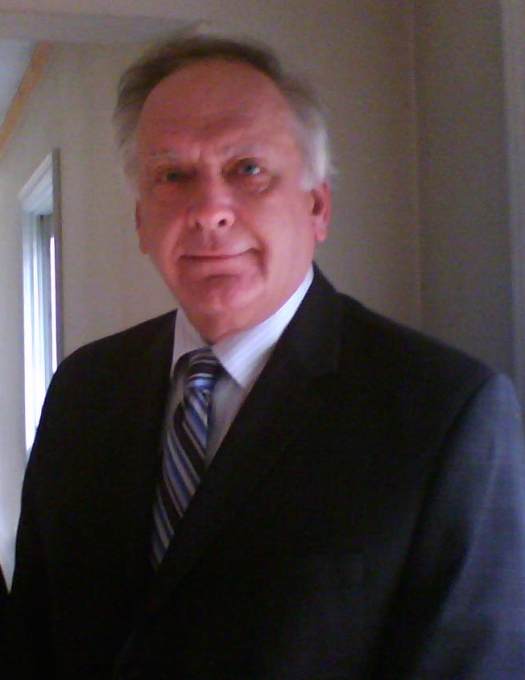
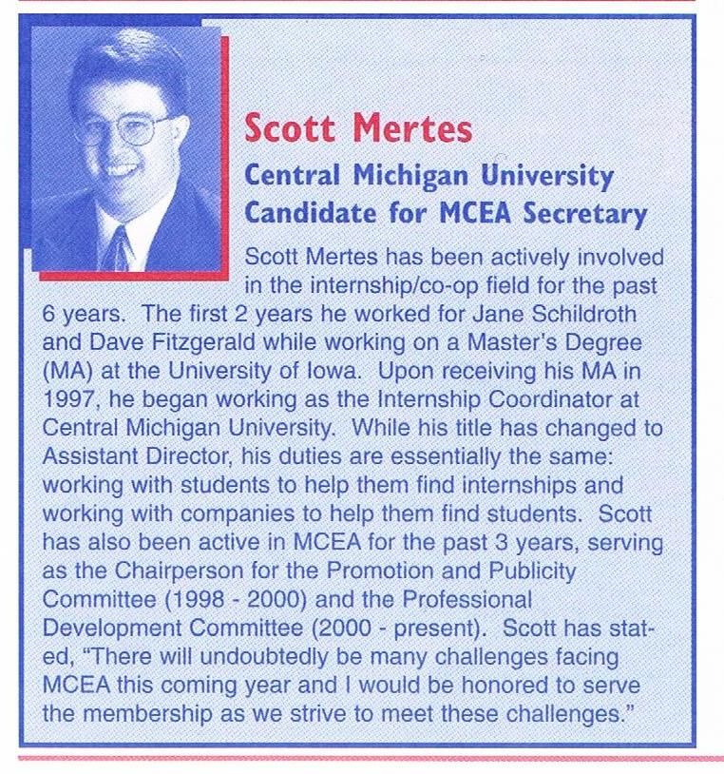
MCEIA Presidents
Joan Smothers– 2004-05
University of Northern Iowa
Scott Mertes– 2003-04
Central Michigan
Ronald Nilsson– 2002-03
Northern Illinois University

Slide 17
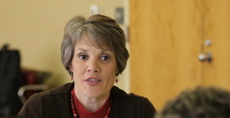
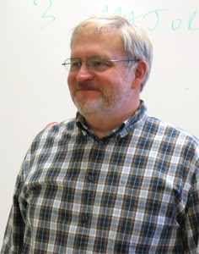
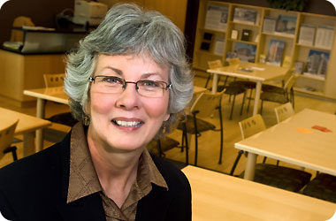
MCEIA Presidents
Patti Jones – 2001-02
University of Michigan - Dearborn
Paul Davis– 2000-01
Cincinnati State
Jane Schildroth – 1999-00
University of Iowa

Slide 18
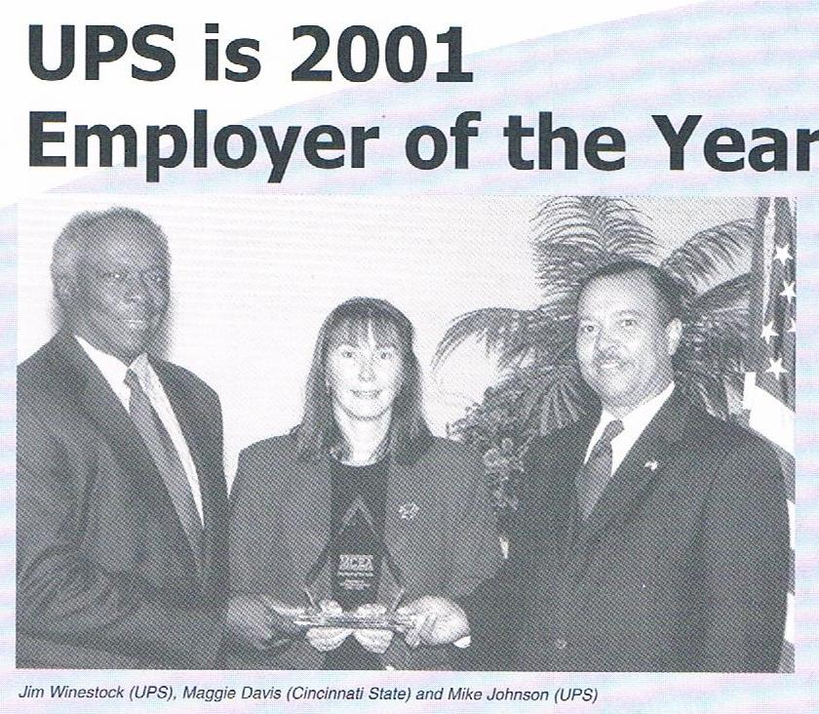
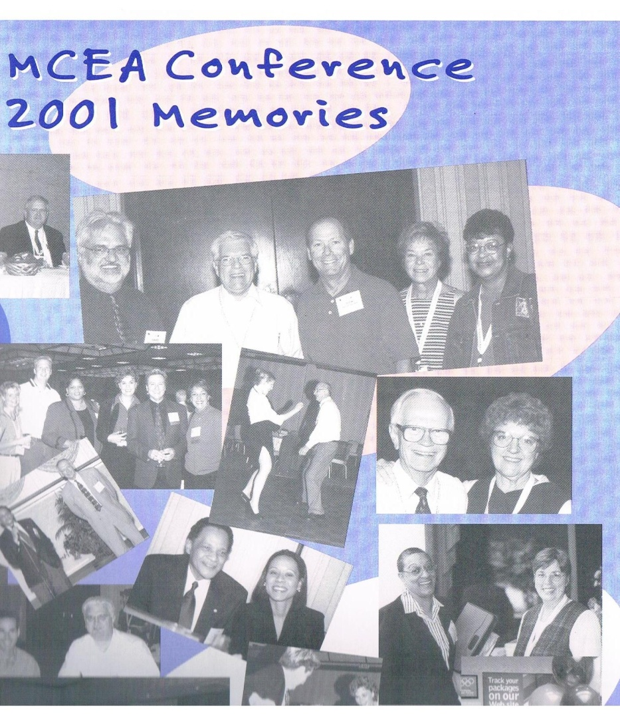
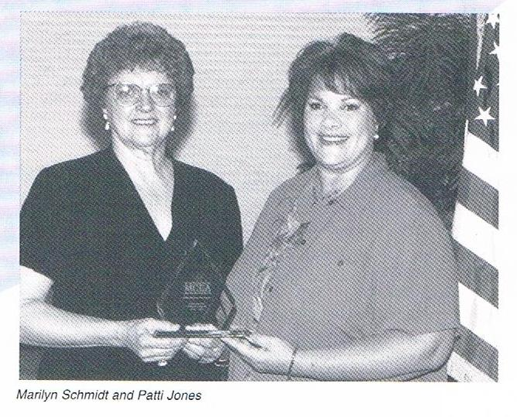
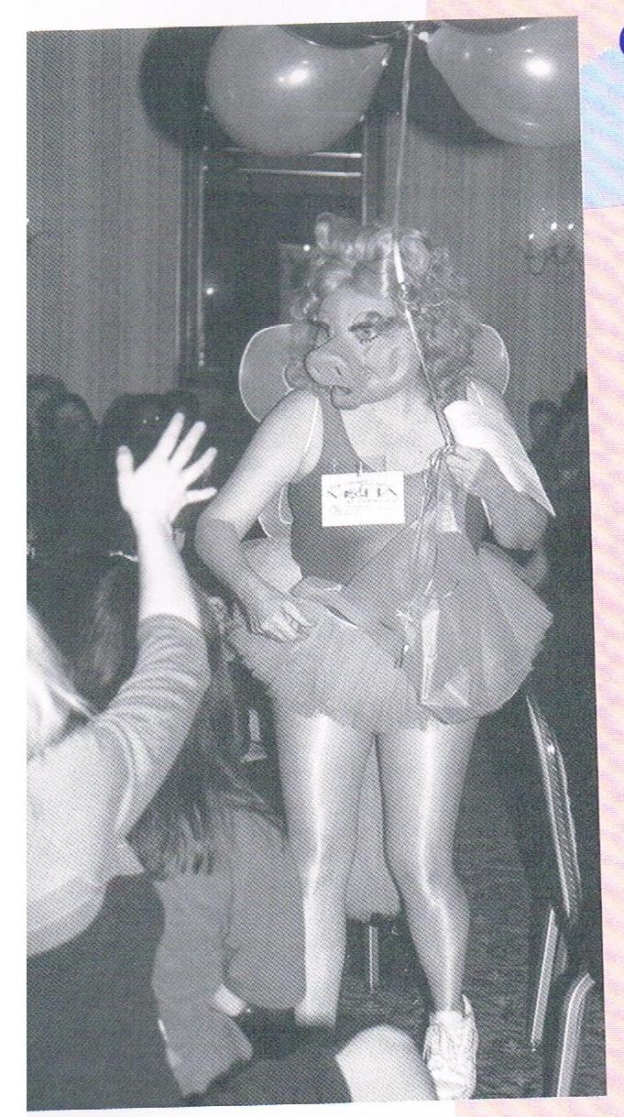
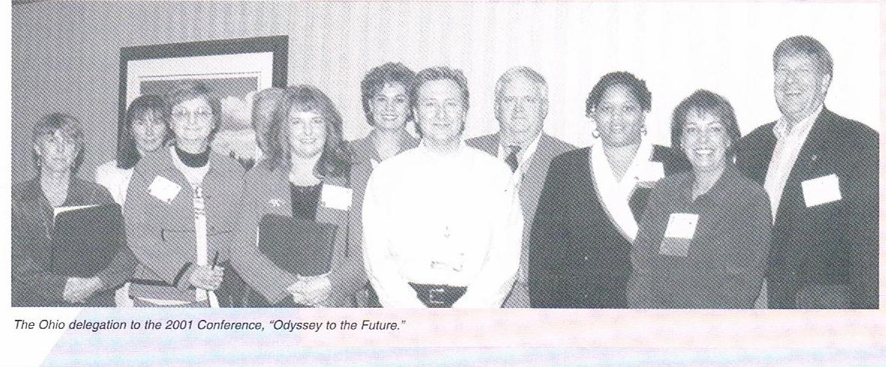

Slide 19
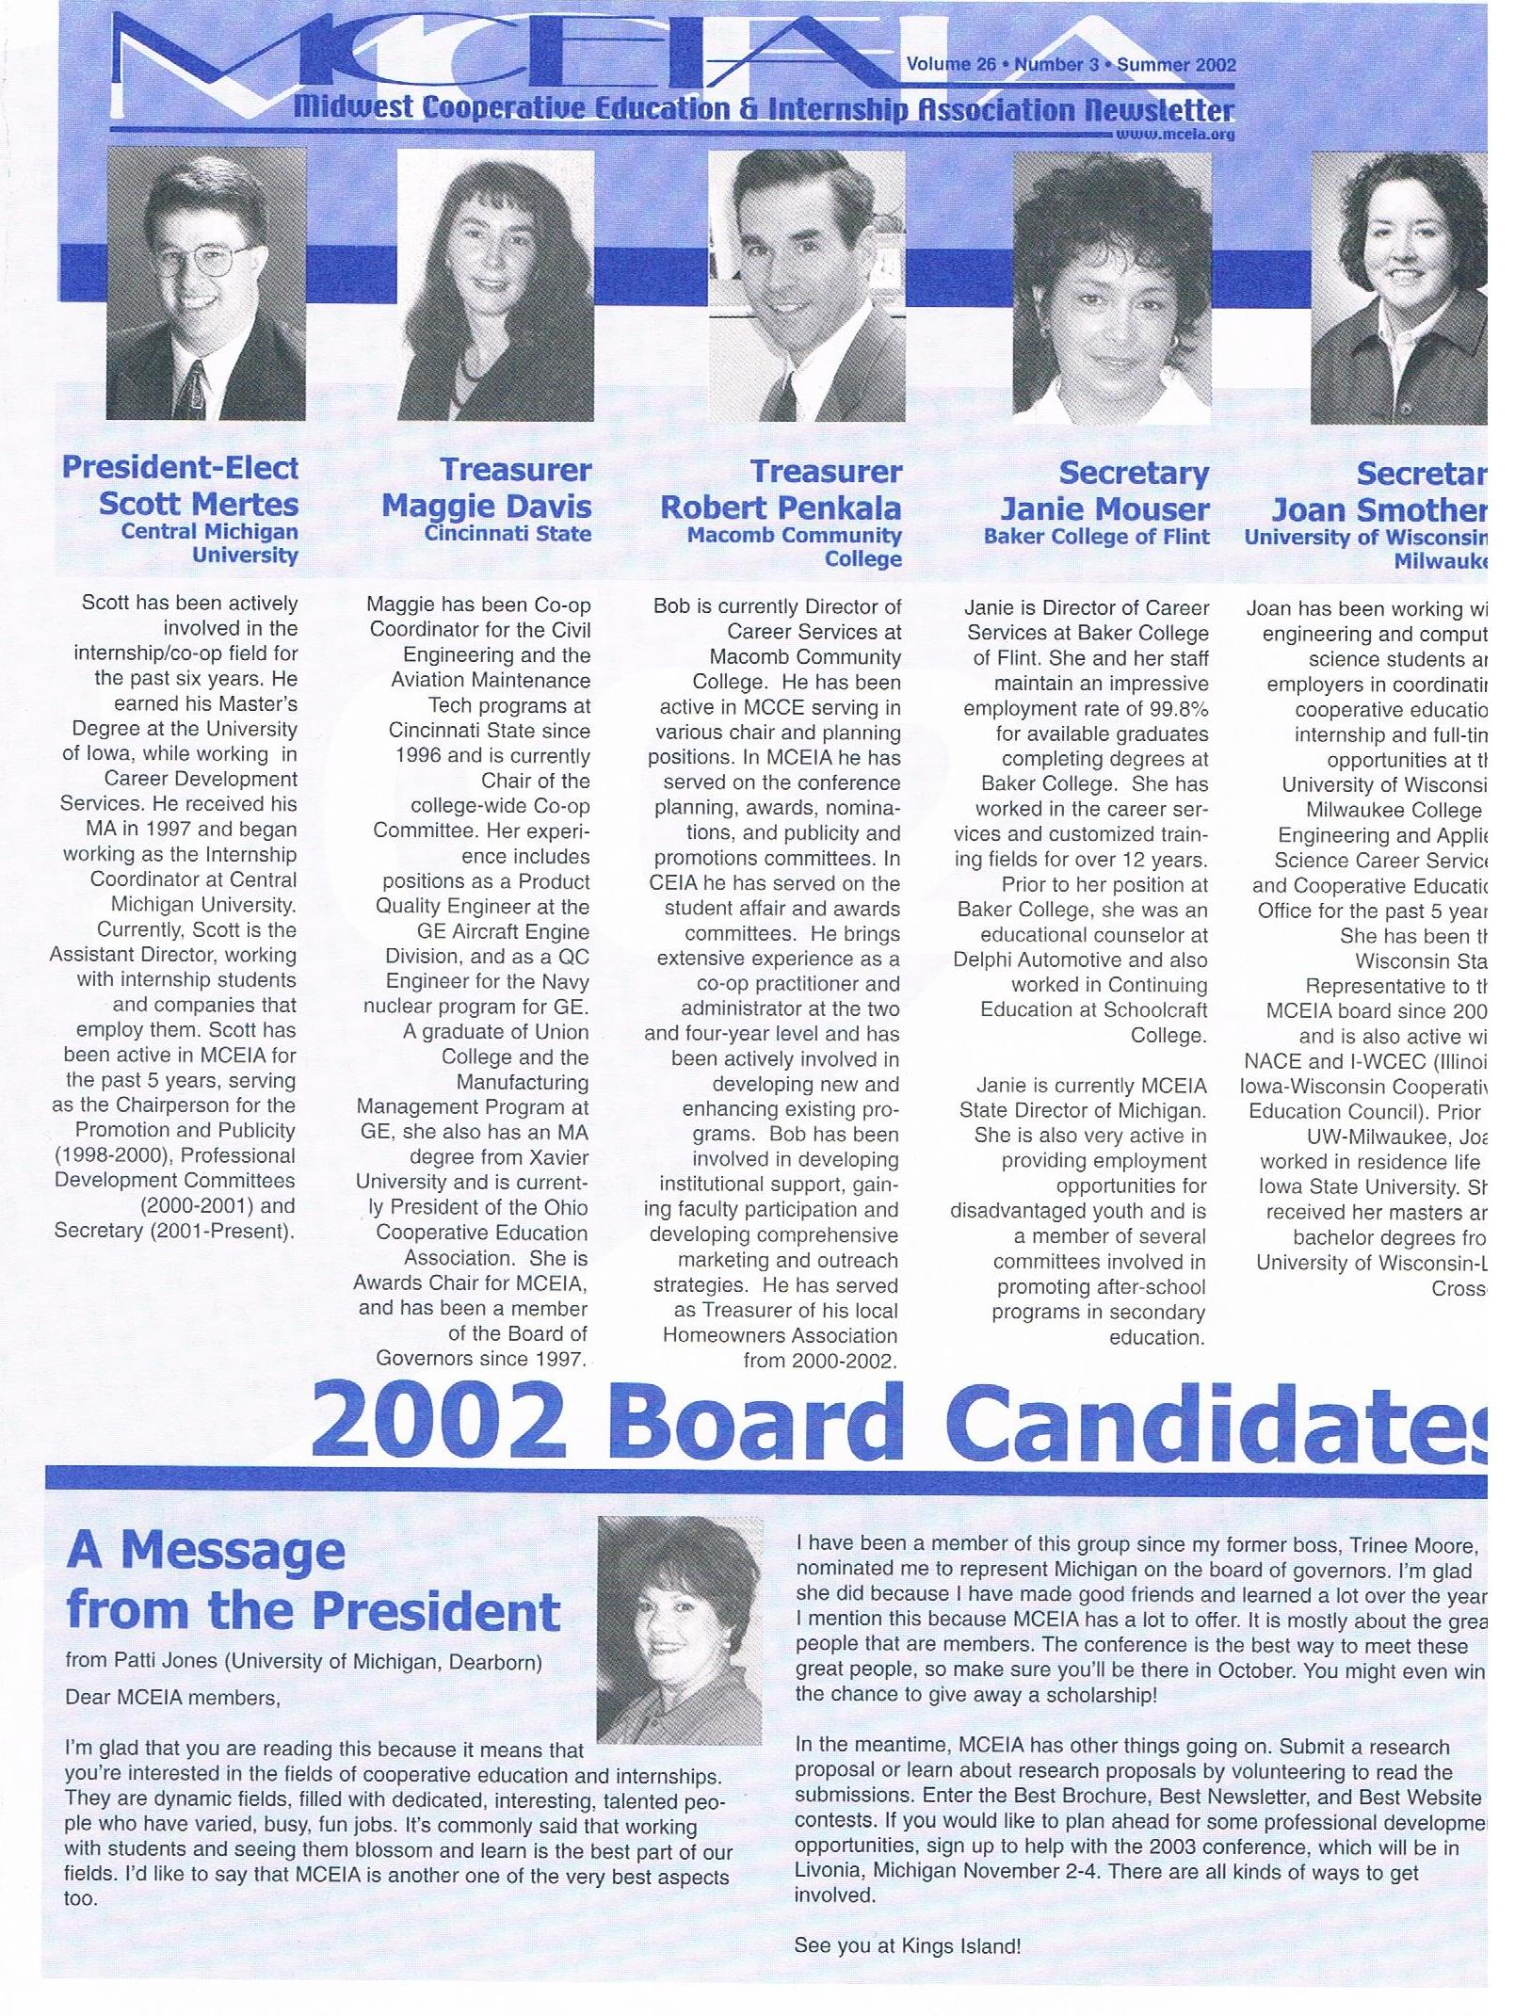
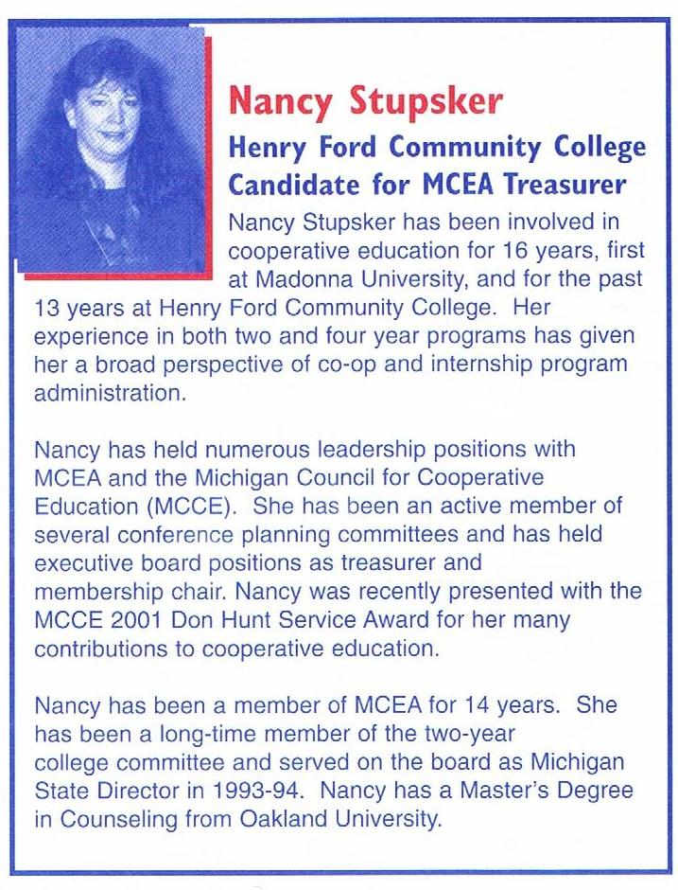

Slide 20
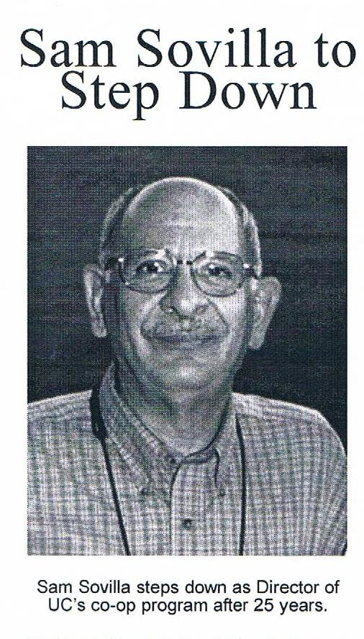
Headlines in the News
2000-2001

Slide 21


Slide 22
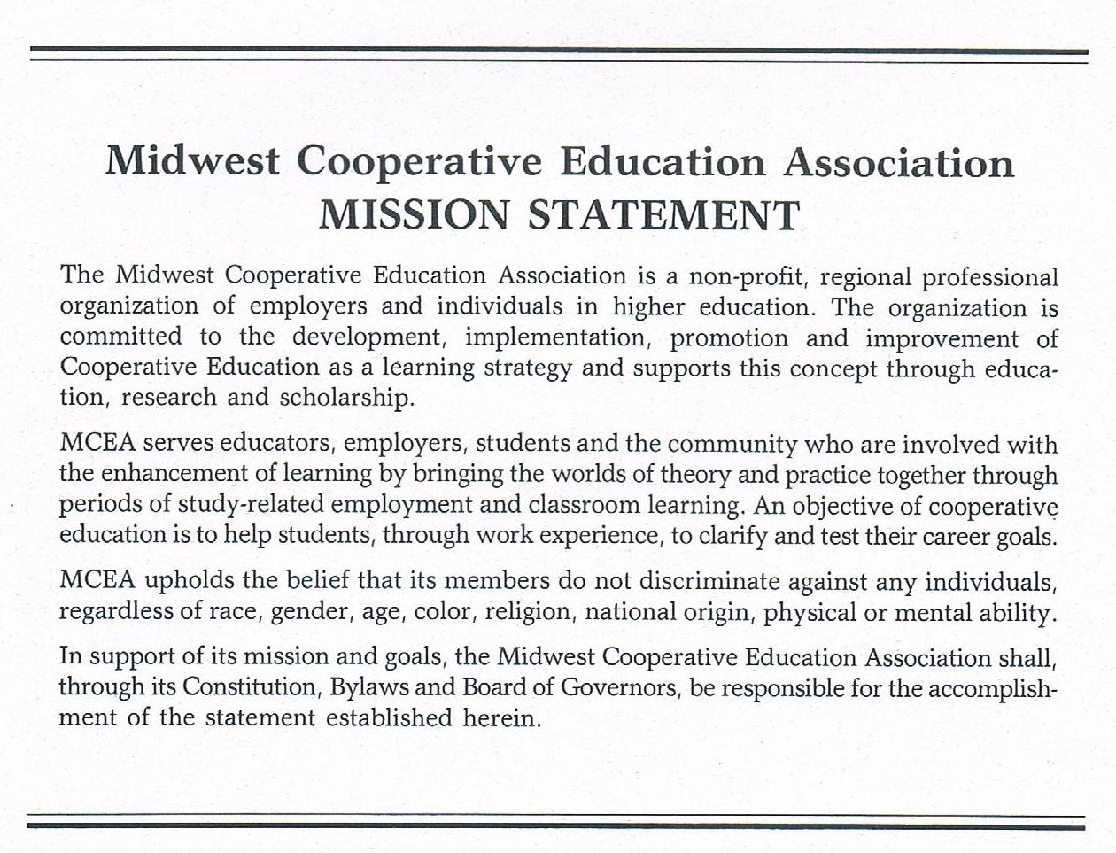

Slide 23


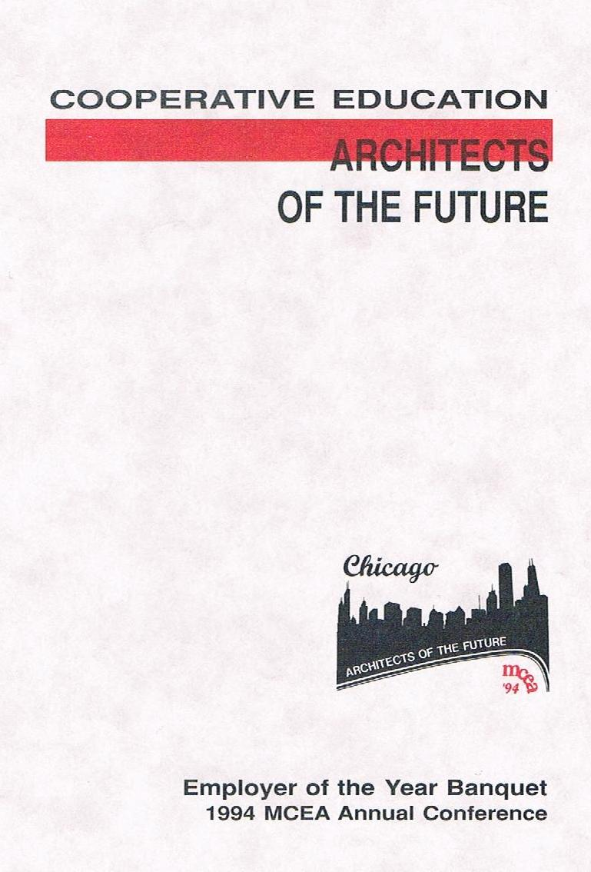
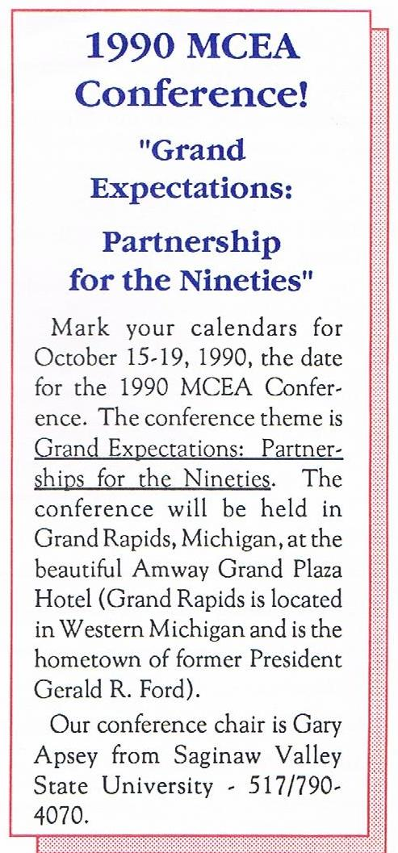


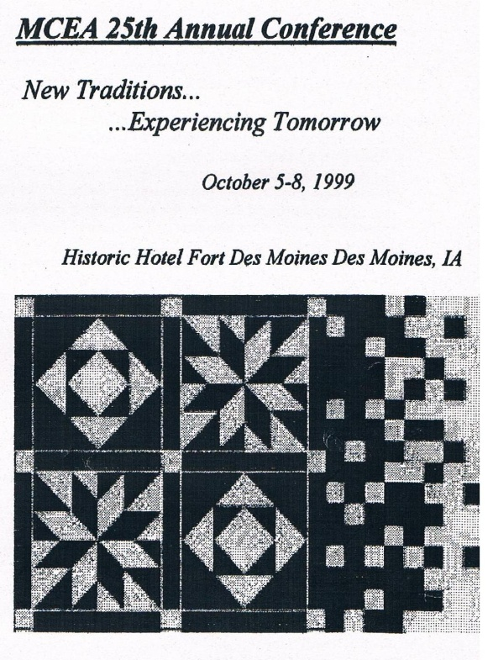
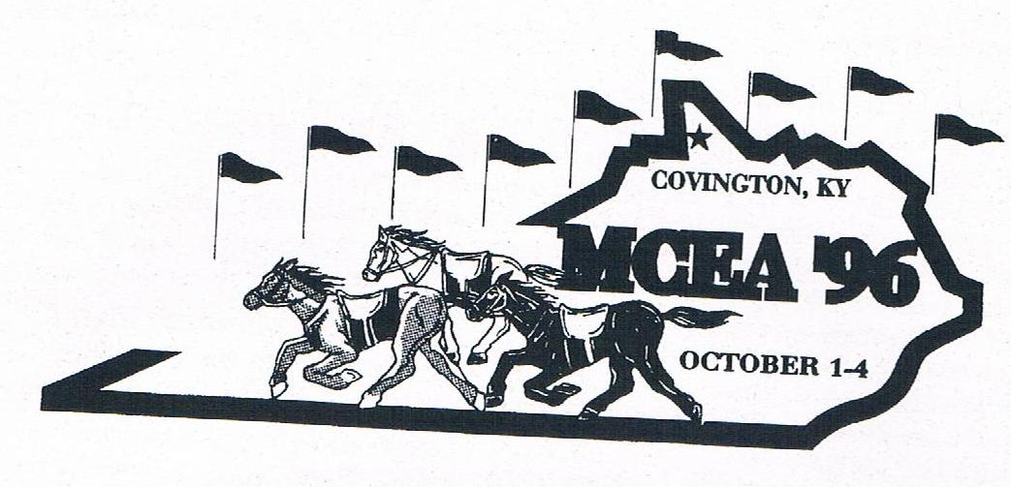

Slide 24




Slide 25


Slide 26



MCEIA Presidents
Gladys Johnson– 1998-99
Cincinnati State
Doug Davis– 1997-98
Northern Illinois University
Peggy Harrier– 1996-97
University of Iowa

Slide 27



MCEIA Presidents
Karen Eagles– 1995-96
Southwest Missouri State
Robi Love– 1994-95
Mead Corporation
Bruce Smith– 1993-94
Bowling Green State University

Slide 28



MCEIA Presidents
Marilyn Schmidt– 1992-93
University of Southern Indiana
Roger Spilde– 1991-92
Concordia College
James Howell– 1990-91
University of Cincinnati

Slide 29



Newsletter Quote 1990

Slide 30



Slide 31


Slide 32


Slide 33


Slide 34





Slide 35



Slide 36


Slide 37



MCEIA Presidents
Vicki Beckman– 1989-90
Milwaukee Area Technical College
Neill Beatty– 1988-89
Oscar Mayer Foods Corporation
Daniel McKenna– 1987-88
Concordia College

Slide 38



MCEIA Presidents
Kathie Wyatt Decker– 1986-87
University of Iowa
John Gerrard– 1985-86
LTV Steel
Richard Abel– 1984-85
University of Cincinnati

Slide 39


MCEIA Presidents
Phillip D. Lavender– 1983-84
GMI Engineering and Management
Bruce T. Evans– 1982-83
University of Cincinnati
Welton Washington– 1982-83
Dow Chemical Company

Slide 40


MCEIA Presidents
Robert Nolan– 1979-80
Public Services Indiana
Chuck Jonas– 1980-81
Cincinnati Technical College

Slide 41


Slide 42




Slide 43



MCEIA Presidents
Gene Hamilton– 1978-79
Saginaw Valley State University
Harold Evans– 1977-78
B.F. Goodrich Company
Marshall E. McGee– 1976-77
Central State University

Slide 44


MCEIA Presidents
Jim Chambers– 1975-76
Burroughs Company
Jack Crusoe– 1975
Wayne State University

Slide 45




Slide 46

1st MCEA
Newsletter

Slide 47

Organizational
Letter
From
Jack
Crusoe

Slide 48



Donald Hunt Lifetime
Achievement Award
Sam Sovilla
University of Cincinnati
Jack Crusoe
University of Detroit
Doug Davis
Northern Illinois
University
Phillip Lavender
Kettering University
Ronald Nilsson
College of DuPage
Roger Spilde
Concordia College

Slide 49

Educators of the Year
Roger Spilde
Concordia College
Ronald Nilsson
College of DuPage
Patti Jones
University of
Michigan-Dearborn
Jack Crusoe
University of Detroit
Marilyn Schmidt
University of Southern
Indiana
Paul Davis
Cincinnati State

Slide 50




Educators of the Year
Peggy Harrier
Cincinnati State
Doug Davis
Northern Illinois
University
Allen Stamberg
University of
Northern Iowa
Dan Cayse
Cincinnati State
Robert Penkala
Macomb Community
College
Helen Oloroso
Northwestern University

Slide 51



Educators of the Year
Jean Paterson
Southern Illinois University
Edwardsville
Diana Burns
Ashland University
Sharon St. Germain
Bradley University

Slide 52













Employers of the Year

Slide 53








Employers of the Year

Slide 54










Employers of the Year

Slide 56
Our History and Tradition
www.mceia.org

